Slide 1
Building evacuation strategies
Dali, Sonu, Tomas

Slide 2
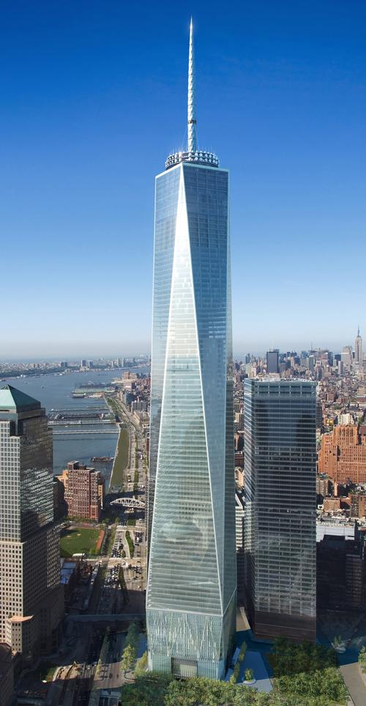
Motivation
Evacuating a large multi-floored structure efficiently is challenging
It is imperative to evacuate everyone as soon as possible
Finding safe and effective evacuation methods is vital to the successful
evacuation of all occupants of the structure

Slide 3
Problem conversion
Convert the floor plan of a building into a graph
Nodes represent different locations
Either a door or an exit
Assume people are located at nodes
Edges represent distances between nodes (doors, exits, etc…)

Slide 4
Floor plan

Slide 5
Approach using Dijkstra’s algorithm
Find the nearest exit for everyone
Congestion at exits is a possibility and assignment to a particular exit may change
as a result while performing the simulated annealing procedure.
Run simulated annealing to arrive at an optimal solution by possible reassignment of exits to certain evacuees in order to minimize congestion
Cost function is the sum of all distances including a penalty for congestion at the exits
Dijkstra followed by simulated annealing should assign the most expedient routes to the exits while avoiding congestion as much as possible

Slide 6
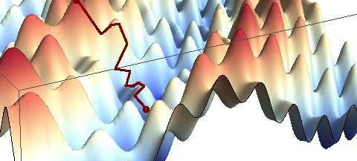
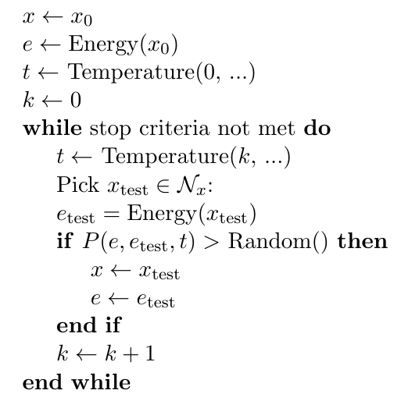
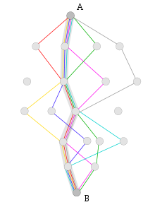
Simulated annealing
Several instances of SA algorithm running in parallel in order to find the most optimal routes. After some interval of temperature change, communication amongst threads is performed using MPI in order to disseminate new interim optimal configuration to all threads. This is continued until SA criteria is met.

Slide 7
Parallelization
Dijkstra algorithm run in parallel for the set of exit nodes
Local optimization using simulated annealing
MPI programming model used to communicate between threads in simulated annealing

Slide 8
Parallel performance results with simulated annealing and MPI

Slide 9
Evacuating 5000 people

Slide 10
Comparison algorithm, APSP
Benchmarked tropical semi-ring APSP against Dijkstra
Fastest parallel APSP implementation was determined to be slower
than serial Dijkstra
Why? Complexity is asymptotically higher:
APSP tropical : O(N⁴) since we perform tropical matrix mult.
N-1 times. With repeated squaring approach we have
O(N³log(N)).
Dijkstra : O(k*N*log(N)) where k = #exits
Floyd-Warshall APSP: O(N³)
APSP also performs more work than necessary as it
finds the shortest paths for ALL pairs of nodes while
Dijkstra (SSSP) may selectively work on relevant node pairs
Parallelizing recursive portion of APSP proved
problematic

Slide 11
Challenges encountered…
Attempts at enforcing edge constraints for two evacuees moving past one another along edges
Simulation of real-time movements for all evacuees
Exit congestion constraints
Simulated Annealing
MPI

Slide 12
Conclusions / Lessons Learned

